Slide 1

Introduction to Android
2023-24

Slide 2
Summary
Android background
Android architecture
Android applications
Application lifecycle

Slide 3
The Android Platform
Android is an open source and comprehensive platform for mobile handsets
It includes the best features of previous mobile platforms
Development Tools are free
Android applications are (mostly) written in the Kotlin or in the Java programming language
Alternatively, a C++ API is available, as well as support for Rust application
There is no distinction between native and third-party applications
All the applications use the same Software Development Kit (SDK)
All the applications can access the underlying hardware

Slide 4
Open Handset Alliance (OHA)
Born in 2007, it is a group of 84 technology and mobile companies who develop open standards for mobile handsets
Google is the leader
Handset Manifacturers
Mobile operators
Semiconductors Companies
OHA
Software Companies
Commercialization Companies

Slide 5
The Android architecture - 1
Android is composed of an operating system and a software platform for creating apps and games
It includes a set of minimal applications (browser, email client)
These basic features can be easily included in other applications
Android has been designed to be robust
It is based on the Linux Operating System Kernel
Every Android application runs in its own process, with its own instance of the virtual machine

Slide 6

The Android architecture - 2
Art/Dalvik virtual machine
Art/Dalvik virtual machine
Art/Dalvik virtual machine
Android
App A
Android
App B
Android
App C
Linux
User A
Linux
User B
Linux
User C
Libraries
Surface Manager
Media framework
SQLite
…other
OpenGL ES
WebKit
SSL
Libraries
Memory
Management
Inter Process
Communication
Network
Display
Keyboard
Touch
Power
Supply
Other drivers
Bluetooth, Camera, Audio,
Phone, Flash Memory,
Sensors
Linux Kernel
Hardware

Slide 7
The Android architecture - 3
The Linux 5.4 (4.19) kernel acts as an hardware abstraction layer (HAL) between the device physical layer and the Android software stack
The Linux kernel manages:
Permissions and security
Low level memory
Processes and threads
Network Layer
Display, keyboard, camera, flash memory, audio files
Every Android application runs in its own process, with its own instance of the ART (Dalvik) virtual machine
Conceptually similar to Java virtual machines…
…but optimized to run on mobile devices

Slide 8

Security
Every application runs with its own user
Once the application is installed, the operating system creates a new user profile associated with it
File system permissions ensure that one user cannot alter or read another user's files
Every application must declare which shared resources will use
For example, making phone calls, using the camera or other sensors
Android will block applications which try to use not declared resources
Every application also requires the permission to access the user’s private data
Such as preferences, user location, user contacts, …
If the permission is not granted, the installation fails

Slide 9
Android Applications Development
The Android SDK exposes a set of APIs, which allows the access the underlying hardware
No distinction between “native applications” and “third-party applications”
Every application, if equipped with the appropriate permissions can use them
Android includes a set of minimal applications such as a browser, and an email client
Third-party provided applications can integrate, extend or even replace them
The main programming languages are Java and Kotlin
But it is possible to develop applications using C++ and Rust, as well

Slide 10
Application Structure (1)
Conceptually, an application consists of a set of data and code designed to perform a given set of tasks
Such information is:
stored in a private space inside the file system
executed in the user context that was created during the installation of the application

Slide 11
Application Structure (2)
Android applications do not have a single entry point, as it happens in other operating systems
Each application consists of one or more components, activated by the operating system, at its own will
The components of the same application are distributed in a single software "package" (apk - Android Package) and are described in a manifest file

Slide 12
Android Components (1)
Each application consists of one or more of the following components:
Activity
Service
ContentProvider
BroadcastReceiver
Each kind of component takes care of a specific interaction with the operating system and/or the user
Component creation, operation, and destruction follow a well defined, OS enforced, life-cycle, according to its kind

Slide 13


Network
Requests
Application
Service
Service
File
File
Files
Activity
Database
Content Provider
Other applications
Activity
Content Provider
Classi
Classi
User
interactions
Classi
Data
requests
Classes
BroadcastReceiver
BroadcastReceiver
System Events
Operating System

Slide 14

Activities
An Activity is a software component that
Has a Graphical User Interface
Can perform a task inside the application
Extends the class android.app.Activity
An application is composed of one or more activities
For example an email client application could be composed of the following Activities
One listing unread inbox messages
One for composing a new message
One for reading a message
Modern applications tend to have few activities (in some cases just one) which may host many “Fragments” or a single surface upon which the GUI is drawn using a declarative approach

Slide 15

Service
A service is a component that can run in the background
It does not provide a user interface
Usually services are used to perform long tasks
A service could play music while the user is using another application
A service could gather network data without blocking the user interaction with another activity
A service is a subclass of android.app.Service

Slide 16

Content Provider
A content provider manages application data
Data can be stored in the file system, in a database, on the web, …
It implements a set of standard methods that allow other applications to fetch and to store data handled by the current application
Other applications do not call its method directly, but they interact via a content resolver
A Content Provider is a subclass of android.content.ContentProvider

Slide 17
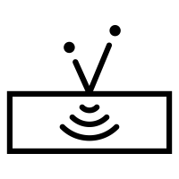
Broadcast Receiver
A Broadcast Receiver is a component which “waits” for messages
Some messages are created by the Operating System
For example, whenever the display is turned off, when the battery is low …
Applications can produce messages, too
For example, when a data transfer is completed
A broadcast receiver does not have a Graphical User Interface, but it can generate notifications in the status bar
To notify the user that a particular message is detected
A Broadcast Receiver is a subclass of android.content.BroadcastReceiver

Slide 18
Application Lifecycle 1/3
The functionality provided by an application are defined by its manifest file
It is an XML document that “signs a sort of contract” between the application and the execution environment
It lists all the single components that compose the application, the requested permissions and their configurations information
When an external event occurs, based on its type and on the components declared in the manifest file, Android creates a new process
Its owner is the one that was created when the application was installed

Slide 19
Application Lifecycle 2/3
For each application in execution, Android instantiates in its process a single object of class android.app.Application
It is possible to specify a subclass of it in the manifest file
This object can be used to store global information shared by all the app components
Android notifies the application object with the evolving status of the ongoing elaboration
fun onCreate(...)
fun onConfigurationChanged(…)
fun onLowMemory()
fun onTerminate()

Slide 20
Application Lifecycle 3/3
Once the application object has been created and initially notified of the beginning of the process, Android instantiates whatever individual component is needed
Based on the reason that caused the process to be started
The application object stays in memory as long as there are active components
The application object is removed from the memory when all the components terminate their lifecycle
It is possible to set up an user-defined Application subclass
It was intended to store global application state
Modern Android application prefer to use the Singleton pattern to achieve the same effect

Slide 21



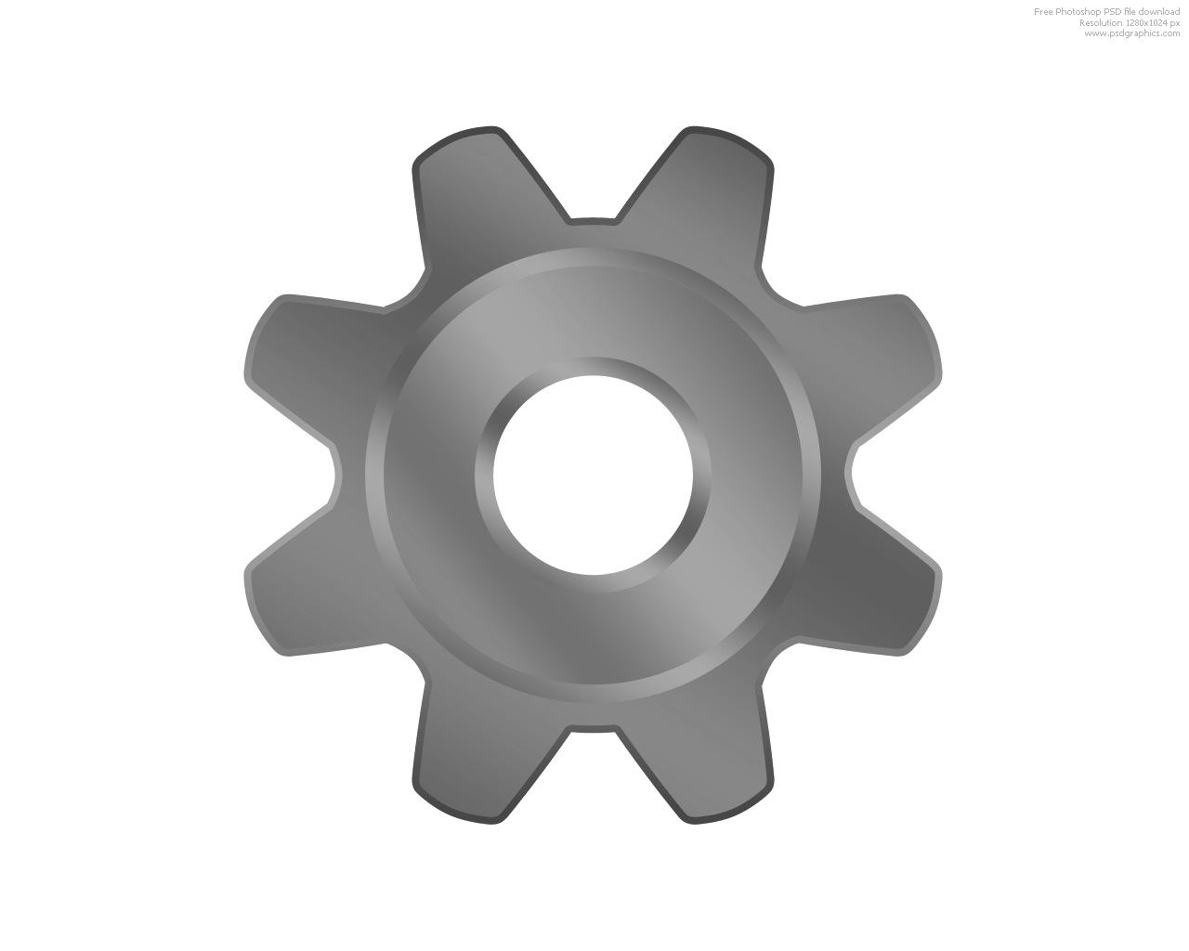

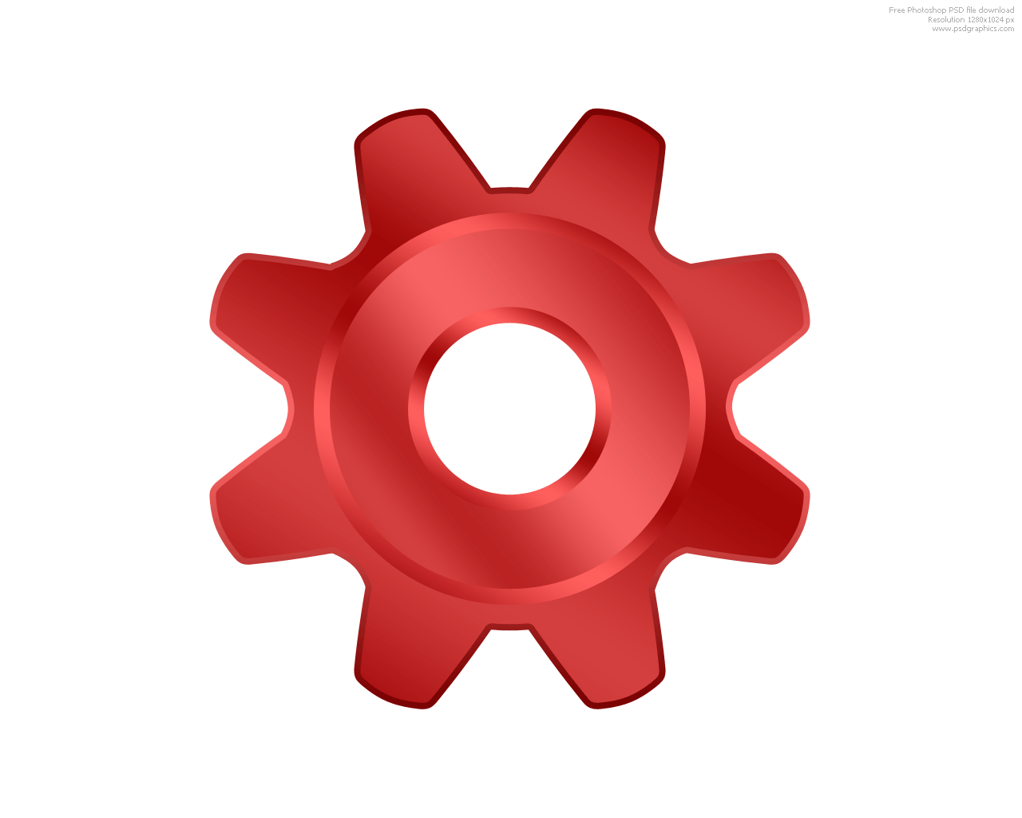

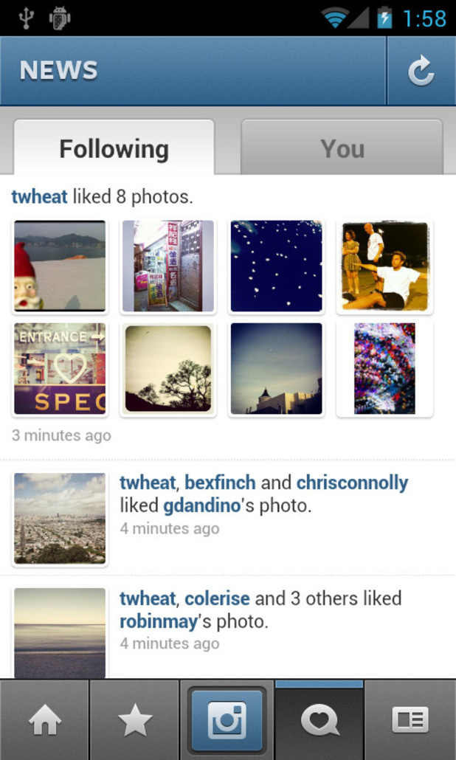
Application Startup
2 – The Zygote system process is forked
3 – A message loop begins
Intent
Intent
manifest
1 – The User taps an icon
4 – An Application
object is created
Activity
Application
onCreate()
onCreate()
6 – A GUI is populated and shown
5 – The main activity
object is created

Slide 22



Application process startup (1)
Whenever an icon of the home screen is tapped, a new process is launched
Information regarding the chosen activity is packaged inside an Intent
The intent is delivered to a system process, named Zygote that forks a brand new process
Intent
Intent

Slide 23
Application process startup (2)
Zygote contains a pre-warmed VM: this reduces the overall startup time
Only application specific classes need to be loaded, since general purpose ones have already been loaded in the parent process
The forked process starts a message loop and uses the information contained in the Intent to locate and load the corresponding APK and manifest file

Slide 24
Application process startup (3)
The main thread of the forked process instantiates an Application object
And invokes the onCreate() method
Subsequently, the activity referred to by the received intent is instantiated
And its onCreate(…) method is invoked
Here (mostly) the customization begins…

Slide 25
Applications interaction
The modular mechanism in which applications are built enable the creation of synergies without building strong interdependence among classes
A particular kind of messages, named intents, may be used to activate other applications and to exchange data with them
An intent defines an action to be performed and a set of data on which to operate
The operating system finds and instantiates the corresponding components that can handle the required action

